Slide 1


DSO528 Blended Data Business Analytics for Efficient Decisions
Logistic Regression
Feng Chen

Slide 2
Learning Objectives
Explain the basics of logistic regression and how it aids in prediction and decision-making.
Identify business opportunities for applying logistic regression.
Compare the advantages and disadvantages of logistic regression vs. decision trees.
Build a simple logistic regression model in Python.

Slide 3
Linear Regression Review

Slide 4
A little bit about history
The term "regression" was coined by Francis Galton in the 19th century to describe a biological phenomenon, regression towards the mean. The heights of descendants of tall ancestors tend to regress down towards a normal average.
His work was later extended by other scientists to statistical context.
The earliest form of regression was least square, which is to minimize the sum of residual squares.
There are many other regression methods.

Slide 5
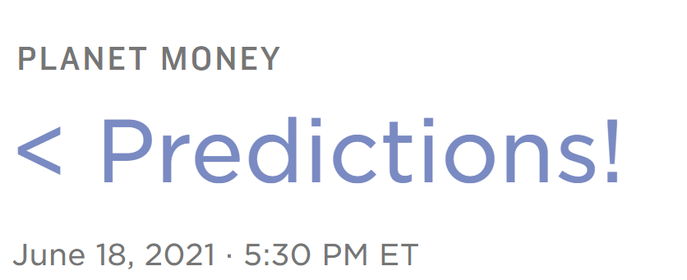
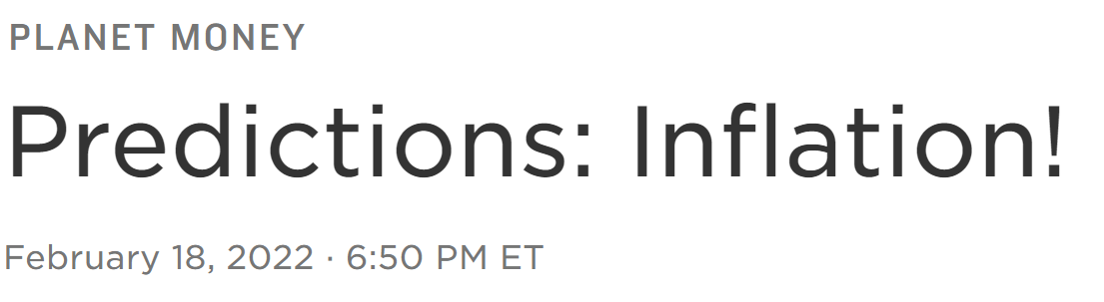
Application example _ prediction
Predicting economic performance by end of year 2021 (Average from two economists)
How fast will the job market bounce back? Adding an average of 300,000 or 400,000 jobs per month
Will inflation spiral out of control?
Inflation coming down to between 2% and 3% for the year
Will the home price boom continue?
Home prices that are still rising pretty quickly (about 8% to 12% a year in home price growth)
Around 400,000
https://www.npr.org/transcripts/1007813310
Around 7%
Around 19%
https://www.npr.org/2022/02/18/1081846617/predictions-inflation

Slide 6
The Linear Regression Model
The ε_{i}’s represent the deviations of Y from the regression line.
The ε_{i}’s are normally distributed with mean 0
σ², the variance of ε_{i}, does not depend on x_{i}
The y_{i}’s (equivalently ε_{i}’s) are independent of one another.

Slide 7
Interpreting the Coefficients
The parameters in the linear regression model are very easy to interpret.
β₀ is the intercept (i.e. the average value for Y if all the X’s are zero), β_{j} is the slope for the jth variable, and X_{i,j} is the ith observation for variable j, etc.
β_{j} is the average increase in Y when X_{j} is increased by one and all other X’s are held constant.

Slide 8
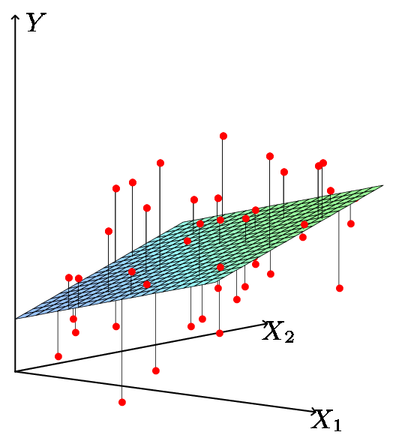
Least Squares Fit
We estimate the parameters using least squares i.e. minimize

Slide 9
Relationship between population and least squares lines
Population line
Least Squares line
We would like to know β₀ through β_{p} ie the population line. Instead, we know through ie the least squares line.
Hence we use through as guesses for β₀ through β_{p} and as a guess for Y_{i}. The guesses will not be perfect just as is not a perfect guess for μ.

Slide 10
Inference in Regression
Estimated (least squares) line.
The regression line from the sample is not the regression line from the population.
What we want to do:
Assess how well the line describes the plot.
Guess the slope of the population line.
Guess what value Y would take for a given X value.
14
12
10
8
6
4
2
0
-10
-5
0
5
10
X
True (population) line. Unobserved

Slide 11
Logistic Regression

Slide 12
Statistical Methods Table
 | Continuous X | Categorical X
Continuous Y | Regression | Regression: Dummy Variables
Categorical Y | Logistic Regression | Contingency Tables

Slide 13
Simple Logistic Regression
We would like to predict if loans will default or not
The response variable, Y, (default) is categorical: 0 or 1
First, we will use only one explanatory variable (FICO) to predict the response variable (default or not)

Slide 14
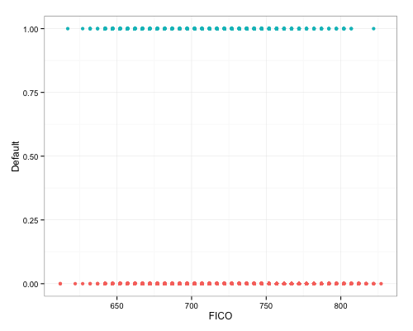
Why Not Linear Regression?
Suppose we fitted a linear regression (line in grey).
If the FICO score is 700, then according to the linear regression line, the value of Default is around 0.2
What does a value of 0.2 for Default mean?

Slide 15
Solution:
Transform the binary Y into Logit →
Instead of trying to predict Y (Default), let’s try to predict P(Default =1)
If we do so, then we can model P(Default =1) using a function that gives output between 0 and 1
We can use logistic function
Logistic Regression!
1.0
0.9
0.8
0.7
0.6
0.5
0.4
0.3
0.2
0.1
0.0
-4
-3
-2
-1
0
1
2
3
4
log odds

Slide 16
The logistic function
This is the same as
1.0
Prob is between 0 and 1
0.9
Logistic Function
0.8
0.7
0.6
0.5
0.4
0.3
0.2
0.1
0.0
-4
-3
-2
-1
0
1
2
3
4
Score
log odds
Log Odds

Slide 17
What does this mean for you?
Why this function?
Statistics classes spend a lot of time
Studying properties of logistic function
Computing the maximum likelihood
Relating scores to probability
This is a business analytics class
Focus on practical applications
Interpret models effectively
Recognize business value
Support decision-making
A Very Elegant Mathematical Theory
Let’s open Colab…

Slide 18

Wrapping up
Explain the basics of logistic regression and how it aids in prediction and decision-making.
Identify business opportunities for applying logistic regression.
Compare the advantages and disadvantages of logistic regression vs. decision trees.
Build a simple logistic regression model in Python.

